Slide 1
Deploy Your .NET Core Web API on as a Serverless Application on AWS
Boston Code Camp 32 – November 23, 2019
Craig Bossie
@cbossie

Slide 2
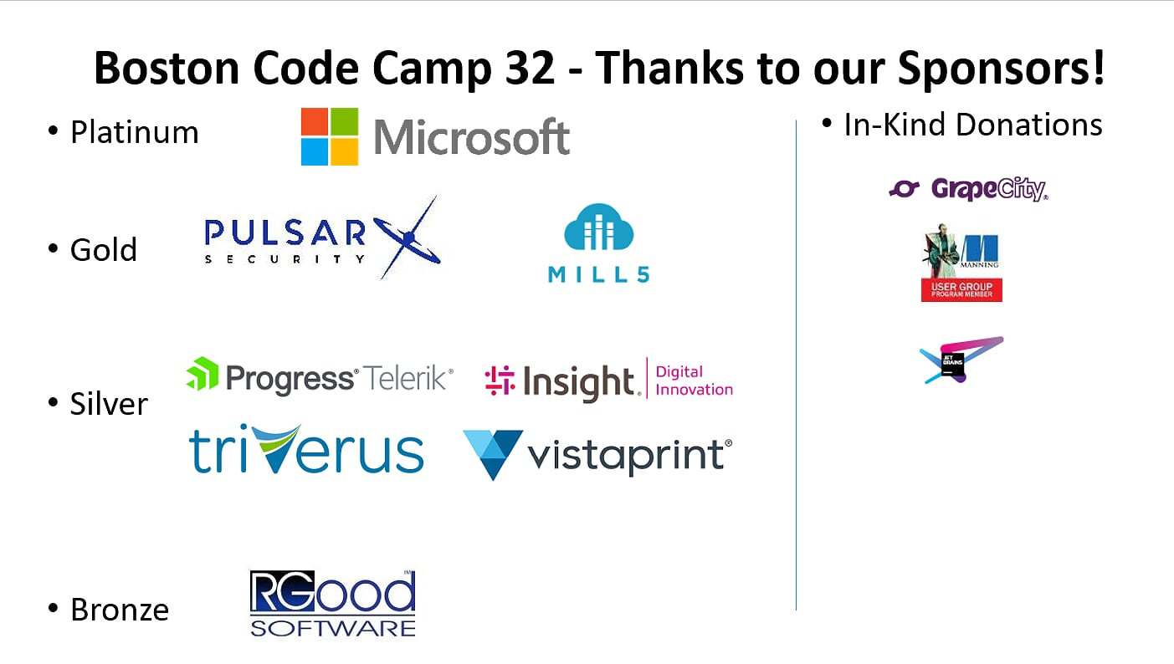

Slide 3
Agenda
Intro
AWS Basics
Function as a Service
AWS Lambda Basics
Introduction to Serverless
Step by Step demos
Make API Serverless
Deploy to AWS with Azure DevOps
Scaling
Notes:
How many of you are Azure Developers?
How many of you are AWS Developers?

Slide 4
Disclaimer
This session is not going to make you an expert in anything!
You will see one example of a technique for running your .NET code as serverless.
This may or may not be the right solution for you or your code. Before committing to running anything in production, you should fully test and profile your code to make sure that it yields the necessary results.

Slide 5

Introduction (Me)
Application Development Consultant, Software Engineer/Architect for about 15 years from the Portland, ME area
Co-founder of the Casco Bay .NET User Group (CBNUG) and the Southern Maine AWS User Group (SMAWSUG)
Been using AWS in some capacity since 2011
Been developing with .NET since 2005
Have a cat that goes into a food coma
Notes:
Serverless for 6 months
NodeJS
Still Keeping up with.NET because it is fun

Slide 6
Introduction (AWS)
Amazon Web Services (AWS) is one of the most popular cloud computing providers, with 23 regions, 69 availability zones.
Offers ~165 services of various types (compute, storage, AI, DB, etc etc etc)
AWS is a cloud provider sometimes thought of as “unfriendly” to Microsoft stack developers
With the release of .NET Core (a truly cross-platform framework), .NET has become a first-class citizen of the AWS platform (which is mostly Linux-based)
Notes:
How many of you are Azure Developers?
How many of you are AWS Developers?

Slide 7
Function as a Service (FaaS)
Allowing the executions small portions of code without having to manage infrastructure, such as virtual machines or server hardware.
Facilitates a microservice architecture.
Differs from “PaaS” (Platform as a service) due to the fact that code is executed on – demand rather than as a process that runs even when not being used.
Characteristics include scalability, cost effectiveness, runtime flexibility
Notes:
Has anyone here used FAAS?

Slide 8
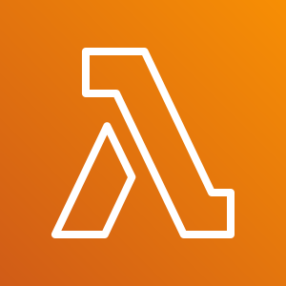
Function as a Service -2 (FaaS)
Azure – Azure Functions
GCP – Cloud Functions
IBM – OpenWhisk
Oracle Cloud – Fn
AWS - Lambda

Slide 9
Lambda Basics
Launched April 9, 2015
Supports NodeJS, Python, Ruby, Java, Go, .NET Core (C#/PowerShell) – or “custom runtime”
Can serve as the target for many other AWS services
Each instance can serve one request at a time
Instances live for a minimum of 5 minutes
Maximum execution time of 15 minutes
Can live inside or outside of a VPC as needed

Slide 10
Serverless
Get it out of your system…
Serverless applications do run on servers!!

Slide 11
Serverless
New, popular cloud model of computing,
A single application is composed of multiple cloud services acting in concert
Code is run on demand, triggered by various external events (we’re talking about http today)
Serverless customers have very little control over resources and the underlying infrastructure
Many tools and frameworks are available to help make deploying serverless applications easier.
Stateless is more important than ever before
Notes:
How many of you are Azure Developers?
How many of you are AWS Developers?

Slide 12
Benefits of Serverless
Serverless applications scale out based on current demand
Reduced complexity
Auto scaling and load balancing are baked-in features
Scaling can respond faster than traditional auto-scaling
Cost is generally significantly lower than a persistently running servers
Applications are split into smaller functions and native services, allowing for more loosely coupled functionality and testable code
Notes:
How many of you are Azure Developers?
How many of you are AWS Developers?

Slide 13
Drawbacks of Serverless
Initial Performance
AWS – Lambda in VPC
Warmup time
Not suited to every workload
Functions have finite lifespan and can be shut down without notice
Code written for the serverless (FaaS) is somewhat specific to that platform
Cloud providers dictate what runtimes/capabilities are available
SQL Connection Pooling can be problematic

Slide 14


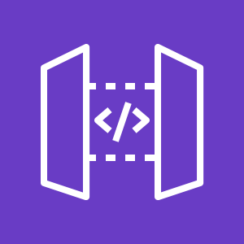






AWS Lamdba Serverless Web Application
AWS Cloud
Other “stuff”
API Gateway
{proxy+}
Client
“Fleet” of Lambda Functions
Cognito Authorizer
Notes:
- .NET SDK for AWS is used to access AWS services
AWS Toolkit for Visual studio is used to create and deploy AWS-Oriented services
AWS Tools for VSTS are used to deploy code (.net and non-.net) to AWS

Slide 15

Serverless Frameworks for AWS
Serverless Application Model
“Out of the Box” Open Source AWS Serverless Framework
Provides an Abstraction Layer on top of CloudFormation
Can run certain runtimes (not .NET) on Docker locally
Serverless Framework
Open source framework that provides simplified interface on top of SAM (and other cloud providers).
Has a plugin framework that can overcome some of the shortcomings/unsupported features of SAM.
Terraform
Allows you to deploy your serverless application using its infrastructure as code model
Zappa
Python-based serverless framework
Claudia.js
Node.js specific framework
Notes:
At conference, sat through several sessions with them.
They said that the AWS toolkit for Visual studio is even used internally because it’s actually better and easier to use than the web interface or the command line tools
- Can do tasks that can be complicated in the web portal or CLI

Slide 16
Running .NET Core on AWS
Options to run your .NET Core on AWS:
Elastic Compute Cloud (EC2) Virtual Machines
Elastic Beanstalk Applications (Pre-packaged Server Hosting)
Elastic Container Service (Hosted Container-Based Computing)
AWS Lambda Serverless
Notes:
Ask the audience who is using AWS, and what are some reasons?
- Why?

Slide 17
Those Three Little Words
LONG
TERM
SUPPORT
AWS Lamdba only Supports .NET Runtimes (Out of the Box) that are in Long Term Support (.NET Core 2.1, .NET Core 3.1)
You can “Bring your own Runtime”
Makes deployment more complicated
Increases startup time (pre-jitted against Amazon Linux can help)

Slide 18
What we are Going to Do
Look at an existing .NET Core 3.0 web API, and run it locally
Add a few libraries and code files and modify a couple of C# files
Deploy our API to AWS and confirm it works
Add CI/CD to our web API by creating a build definition in Azure DevOps
See the scaling ability of Serverless in Action
Notes:
At conference, sat through several sessions with them.
They said that the AWS toolkit for Visual studio is even used internally because it’s actually better and easier to use than the web interface or the command line tools
- Can do tasks that can be complicated in the web portal or CLI

Slide 19

Our Web API Before
On Prem Redis
Plain .NET Core Web API
Client
Notes:
- .NET SDK for AWS is used to access AWS services
AWS Toolkit for Visual studio is used to create and deploy AWS-Oriented services
AWS Tools for VSTS are used to deploy code (.net and non-.net) to AWS

Slide 20
Our Web API After
AWS Cloud
API Gateway
Cloud Redis
Client
“Fleet” of Lambda Functions
Notes:
- .NET SDK for AWS is used to access AWS services
AWS Toolkit for Visual studio is used to create and deploy AWS-Oriented services
AWS Tools for VSTS are used to deploy code (.net and non-.net) to AWS

Slide 21
Demo 0: Create New Web API
AWS Toolkit for Visual Studio
Notes:
Things to demo
How to set up profiles
Different services
EC2
S3
IAM
Security Group
Project templates

Slide 22
Demo 1: Existing Web API
Boring old API
Notes:
Things to demo
How to set up profiles
Different services
EC2
S3
IAM
Security Group
Project templates

Slide 23
Demo 2: Augment API for Serverless
We can rebuild it. We have the technology
Notes:
Things to demo
How to set up profiles
Different services
EC2
S3
IAM
Security Group
Project templates

Slide 24
How to Turn API into Serverless API
5 (actually pretty easy) steps
Add and configure SAM template
serverless.template
Add necessary Nuget Packages
Amazon.Lambda.AspNetCoreServer
Amazon.Lambda.Core
Amazon.Lambda.RuntimeSupport
Create “Lambda Entry Point”
Specify the function handler that AWS lambda will trigger

Slide 25
How to Turn API into Serverless API (2)
6 (actually pretty easy) steps
Modify Program.cs
Use Lambda Entry Point when running in the cloud
Add and configure AWS Lambda tools for .NET Core
“dotnet lambda” command aws-lambda-tools-defaults.json configuration file
Optional: Add Bootstrap Shell Script
The “magic” for .NET Core 3.0

Slide 26
Demo 3: Deploy (the Easy Way)
DEV OPS FROM LOCALHOST (Command Line and Visual Studio)
Notes:
Things to demo
How to set up profiles
Different services
EC2
S3
IAM
Security Group
Project templates

Slide 27
Demo 4: Deploy (the Right Way)
Azure Dev Ops
Notes:
Things to demo
How to set up profiles
Different services
EC2
S3
IAM
Security Group
Project templates

Slide 28
Demo 5: Scaling In Action
Scale out
Notes:
Things to demo
How to set up profiles
Different services
EC2
S3
IAM
Security Group
Project templates

Slide 29
Scaling
On startup, our API identifies itself as a guid. Every request made, increments that guid (in redis) by 1
Run locally 100 times – Look at concurrency statistics for single, multi-request instance.
Run on AWS 100 times – Look at concurrency statistics for single-request container.

Slide 30
Conclusion
Serverless provides an efficient, inexpensive way to run your code
Your .NET Core Web API can run on AWS Lambda, almost unmodified
You can integrate your ASP.NET Web API, deployed on AWS, into your Azure DevOps pipeline.

Slide 31
Resources
AWS Toolkit for Visual Studio
https://aws.amazon.com/visualstudio/
.NET Core 3.0 on Lambda
https://aws.amazon.com/blogs/developer/net-core-3-0-on-lambda-with-aws-lambdas-custom-runtime/
AWS SDK for .NET Twitter Account
@awsfornet
AWS .NET Developer Blog
https://aws.amazon.com/blogs/developer/category/programing-language/dot-net/

